Slide 1
MS&E228: Lecture 2 Causality via Experiments
Vasilis Syrgkanis
Assistant Professor
Management Science and Engineering
(by courtesy) Computer Science and Electrical Engineering
Institute for Computational and Mathematical Engineering

Slide 2
Causal Inference with Experiments
Prediction with Linear Models
Prediction with High-Dim Linear Models
Inference on Causal and Predictive Effects with High-Dim Linear Models
Potential Outcomes and Conditional Ignorability
Structural Equation Models and Conditional Exogeneity
Directed Acyclic Graphs
Prediction with Non-Linear Models
Inference on Causal Effects with Non-Linear Models
Un-observed Confounding and Instruments
Advanced Topics
Estimation of Heterogeneous Causal Effects
Linear Predictive Models and Statistical Inference
Causal Identification in Observational Data
Non-Linear Predictive Models and Statistical Inference
Topics

Slide 3
Causal Inference with Experiments
Prediction with Linear Models
Prediction with High-Dim Linear Models
Inference on Causal and Predictive Effects with High-Dim Linear Models
Potential Outcomes and Conditional Ignorability
Structural Equation Models and Conditional Exogeneity
Directed Acyclic Graphs
Prediction with Non-Linear Models
Inference on Causal Effects with Non-Linear Models
Un-observed Confounding and Instruments
Advanced Topics
Estimation of Heterogeneous Causal Effects
Linear Predictive Models and Statistical Inference
Causal Identification in Observational Data
Non-Linear Predictive Models and Statistical Inference
Topics

Slide 4

The Basics of A/B Testing
Randomization, Causality, Statistical Inference

Slide 5

The Mechanics

Slide 6

A/B Testing
user base

Slide 7

A/B Testing
user base
sample

Slide 8

A/B Testing
user base
sample
flip a coin for each user

Slide 9





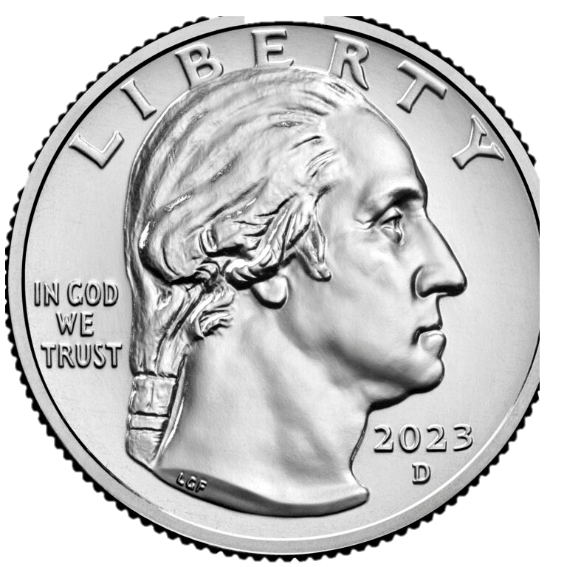










A/B Testing
user base
sample
split into groups based on coin

Slide 10
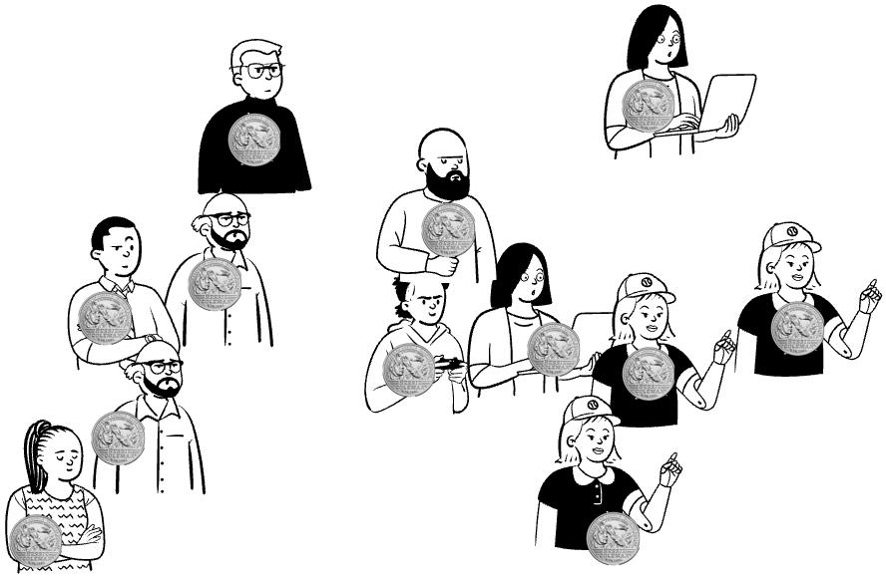

A/B Testing
Group A
user base
Group B
Image Source: https://www.leadpages.com/blog/ab-testing-split-testing/

Slide 11

A/B Testing
A
Group A
user base
B
Group B
Image Source: https://www.leadpages.com/blog/ab-testing-split-testing/

Slide 12

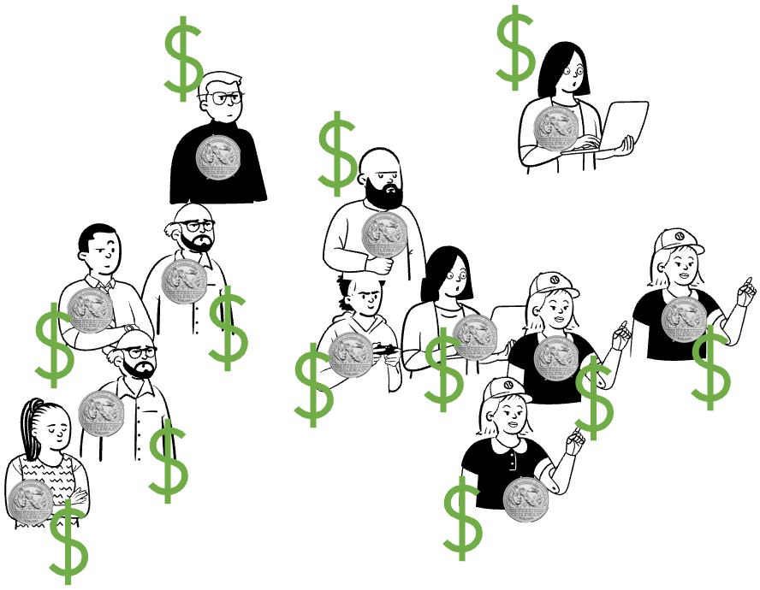
A/B Testing
A
Group A
user base
B
Group B
Image Source: https://www.leadpages.com/blog/ab-testing-split-testing/

Slide 13
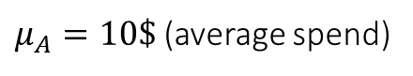
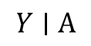
A/B Testing
A
% of people
Group A
user base
$$Y∣A$$
$μ_{A}=10\$$ (average spend)
B
Group B
Image Source: https://www.leadpages.com/blog/ab-testing-split-testing/

Slide 14
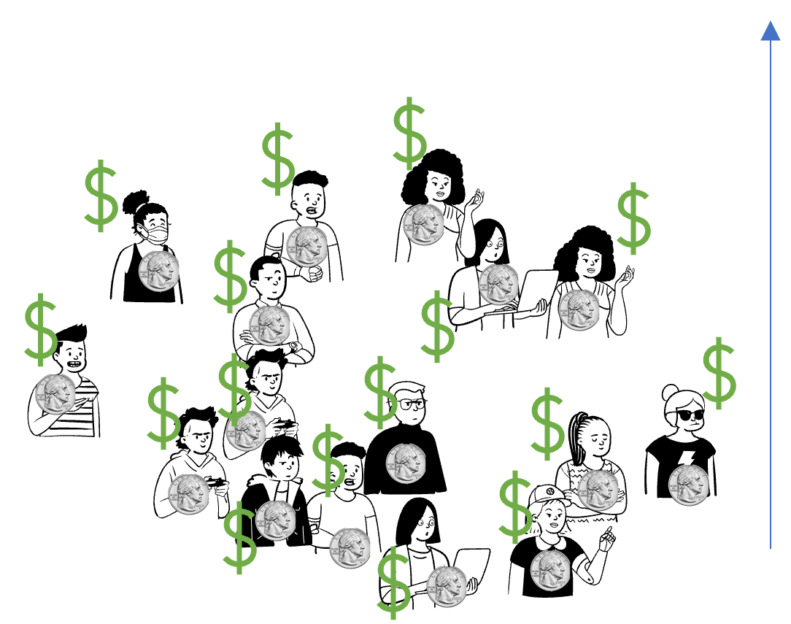
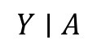
A/B Testing
A
% of people
Group A
user base
$$Y∣A$$
$μ_{A}=10\$$ (average spend)
B
Group B
Image Source: https://www.leadpages.com/blog/ab-testing-split-testing/

Slide 15
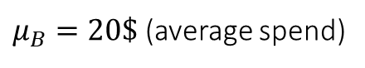
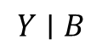
A/B Testing
A
% of people
Group A
user base
$$Y∣A$$
$μ_{A}=10\$$ (average spend)
B
% of people
Group B
$$Y∣B$$
Image Source: https://www.leadpages.com/blog/ab-testing-split-testing/
$μ_{B}=20\$$ (average spend)

Slide 16
A/B Testing
A
% of people
Group A
Control
Baseline
Status quo
$$Y∣A$$
$μ_{A}=10\$$ (average spend)
B
% of people
Group B
Treatment Innovation
$$Y∣B$$
Image Source: https://www.leadpages.com/blog/ab-testing-split-testing/
$μ_{B}=20\$$ (average spend)

Slide 17
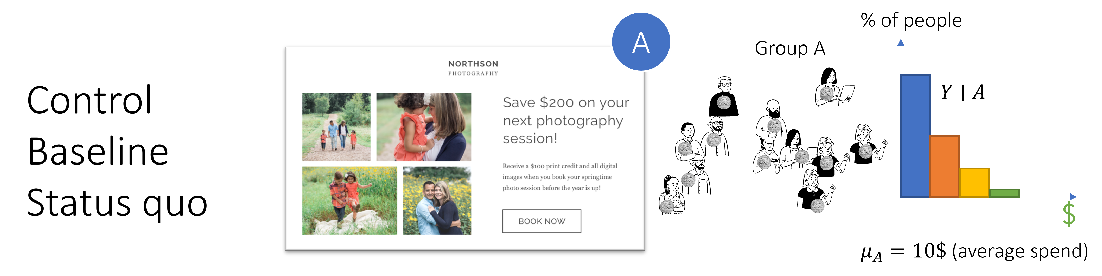
A/B Testing
B
% of people
Group B
Treatment Innovation
$$Y∣B$$
Image Source: https://www.leadpages.com/blog/ab-testing-split-testing/
$μ_{B}=20\$$ (average spend)

Slide 18
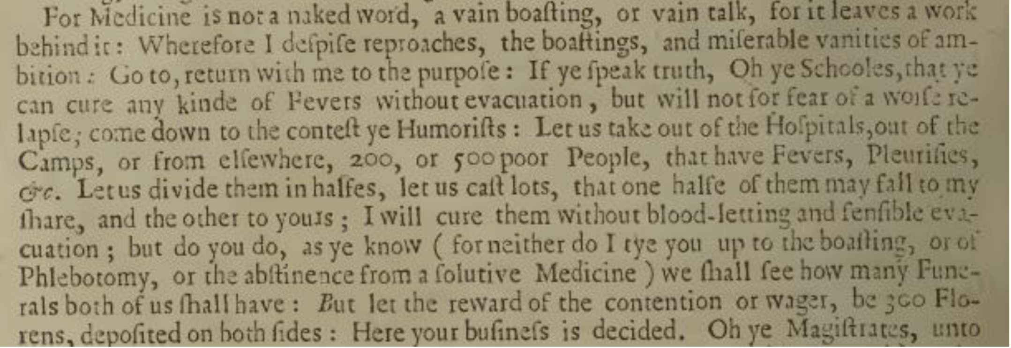
A Brief History of Experimentation
Abhijit Banerjee, Esther Duflo, and
Michael Kremer, popularize the use of RCTs in economics (esp. for policy problems related to poverty).
Neyman publishes “On the Application of Probability Theory to Agricultural Experiments”
Michigan Supreme Court authorizes RCTs as part of medical practice
FDA to prohibit the marketing of any new drug in the absence of “substantial evidence.”
1662
1828
1923
1925
1935
1947
1962
1969
2000-
John Baptista Van Helmont proposes a randomized experiment for the effect of bloodletting
Louis conducts a non-randomized controlled experiment showing strong evidence against bloodletting
Fisher publishes Statistical Methods for Research Workers
Fisher publishes The Design of Experiments
First published medical RCT in Great Britain
FDA: “…partially controlled studies are not acceptable evidence to support claims of effectiveness”
10s of thousands of RCTs run annually by companies like Airbnb, Amazon, Booking.com eBay, Facebook, Google, LinkedIn, Lyft, Microsoft, Netflix, Twitter, Uber, Yahoo! and Yandex
Credit: Ron Kohavi, History of Controlled Experiments

Slide 19
RCTs are the gold standard for measuring the “causal effect” of a “treatment” on an “outcome”

Slide 20
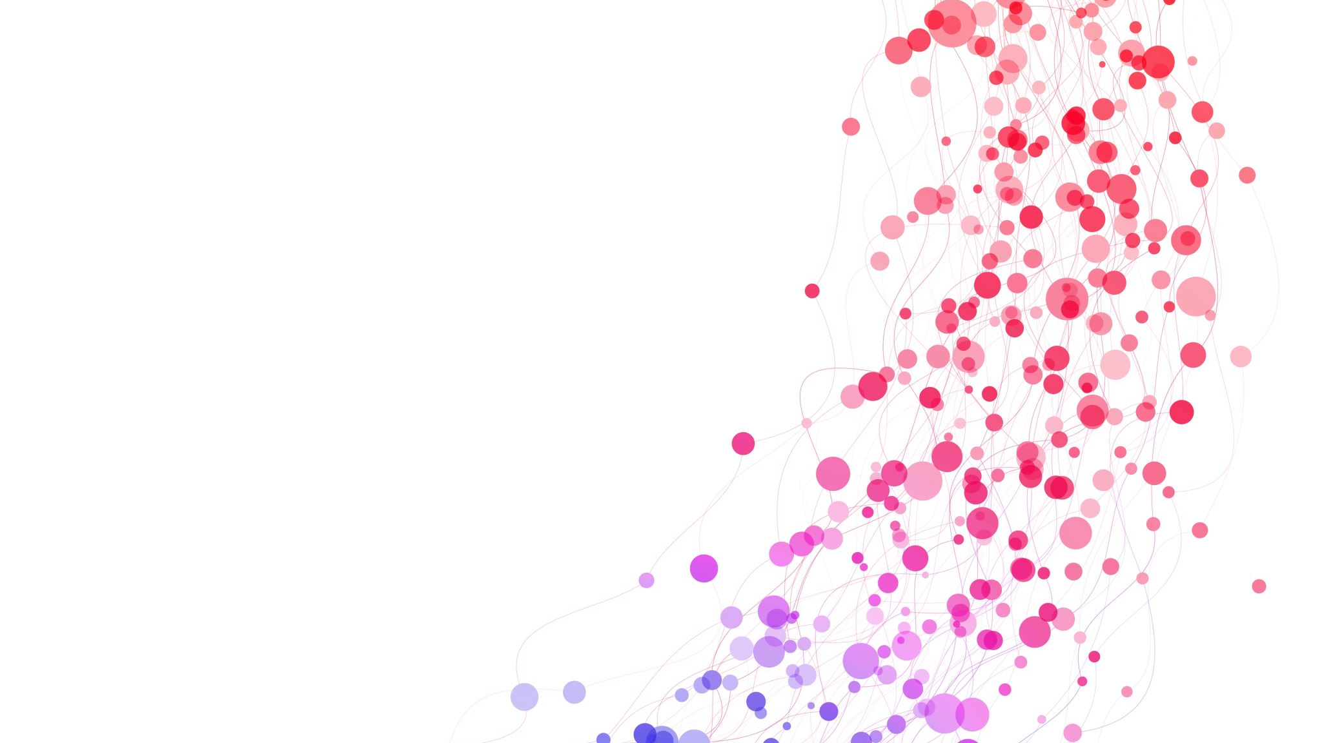
Causality

Slide 21
Goal #1: Mathematical Definition of Causality
We want to formally (mathematically) define the causal effect of a binary treatment on a scalar outcome of interest
Examples
Effect of seed $A$ vs $B$ on crop yield
Effect of completion of a job training program on observed wage
Effect of drug vs placebo on overall survival
Effect of an ad impression on conversion (purchase)
Effect of eating avocados on longevity

Slide 22
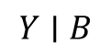
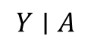
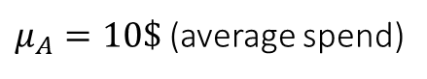
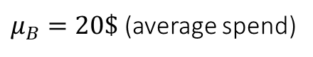
Causal Effect
% of people
Group A
A
$$Y∣A$$
$μ_{A}=10\$$ (average spend)
% of people
Group B
Counterfactual Outcome
B
$$Y∣B$$
$μ_{B}=20\$$ (average spend)
Image Source: https://www.leadpages.com/blog/ab-testing-split-testing/

Slide 23

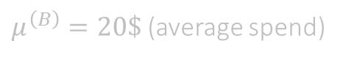
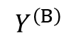
Causal Effect
% of people
Group A
A
$$Y∣A$$
$μ_{A}=10\$$ (average spend)
% of people
% of people
Group B
Counterfactual Outcome
B
$$Y∣B$$
$$Y^{\left(B\right)}$$
$μ_{B}=20\$$ (average spend)
$μ^{\left(B\right)}=20\$$ (average spend)
Image Source: https://www.leadpages.com/blog/ab-testing-split-testing/

Slide 24
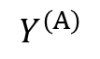
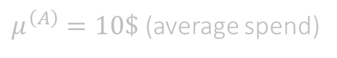
Causal Effect
% of people
% of people
Group A
Counterfactual Outcome
A
$$Y∣A$$
$$Y^{\left(A\right)}$$
$μ_{A}=10\$$ (average spend)
$μ^{\left(A\right)}=10\$$ (average spend)
% of people
% of people
Group B
Counterfactual Outcome
B
$$Y∣B$$
$$Y^{\left(B\right)}$$
$μ_{B}=20\$$ (average spend)
$μ^{\left(B\right)}=20\$$ (average spend)
Image Source: https://www.leadpages.com/blog/ab-testing-split-testing/

Slide 25
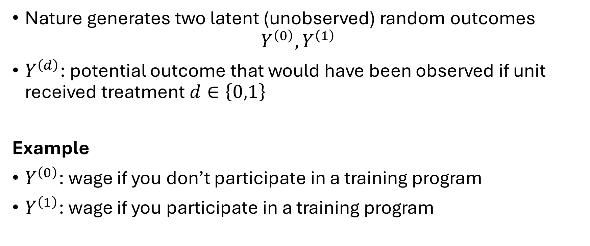
Causality via Potential Outcomes
Nature generates two latent (unobserved) random outcomes
$$Y^{\left(0\right)}, Y^{\left(1\right)}$$
$Y^{\left(d\right)}$: potential outcome that would have been observed if unit received treatment $d∈\left\{0,1\right\}$
Example
$Y^{\left(0\right)}$: wage if you don’t participate in a training program
$Y^{\left(1\right)}$: wage if you participate in a training program

Slide 26
Causality via Potential Outcomes
$Y^{\left(0\right)},Y^{\left(1\right)}$ are called “counterfactuals” as they can never be simultaneously observed
Fundamental problem of causal inference
Example
We don’t have two replicas of each unit
We cannot observe your wage with the training program and without

Slide 27
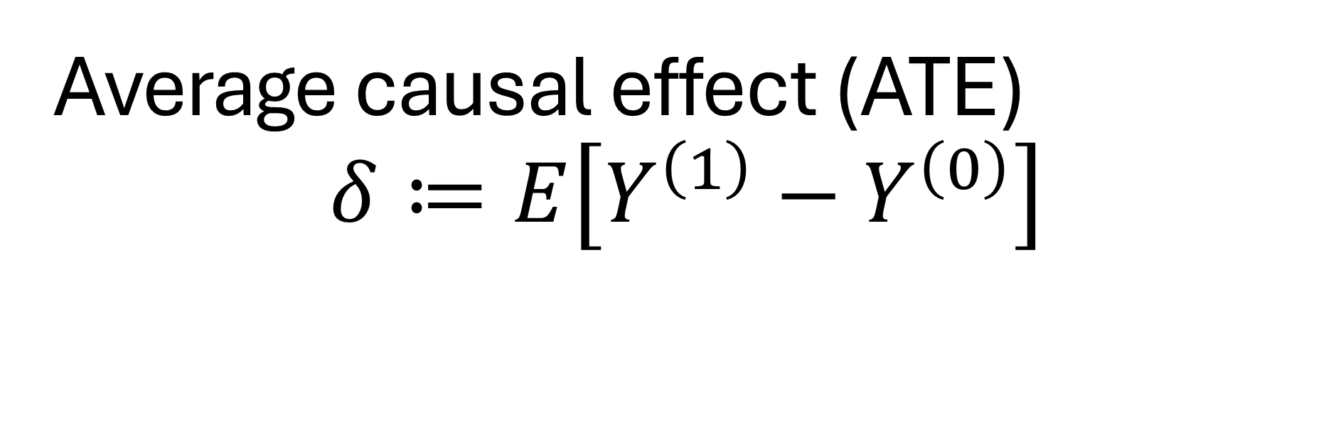
Average causal effect (ATE) $$δ≔E\left[Y^{\left(1\right)}−Y^{\left(0\right)}\right]$$

Slide 28
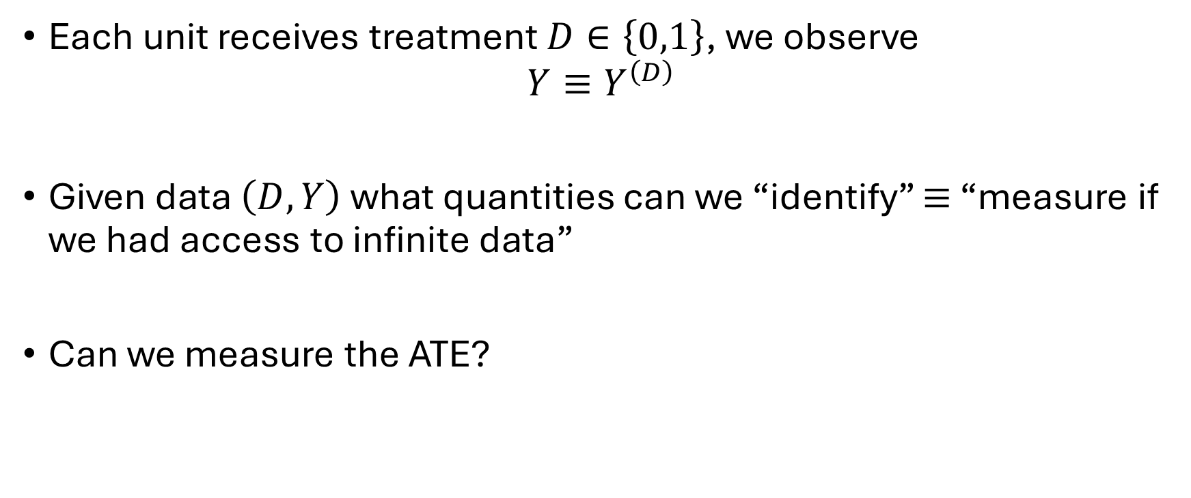
Treatment Assignment and Observed Data
Each unit receives treatment $D∈\left\{0,1\right\}$, we observe
$$Y≡Y^{\left(D\right)}$$
Given data $\left(D, Y\right)$ what quantities can we “identify” $≡$ “measure if we had access to infinite data”
Can we measure the ATE?

Slide 29
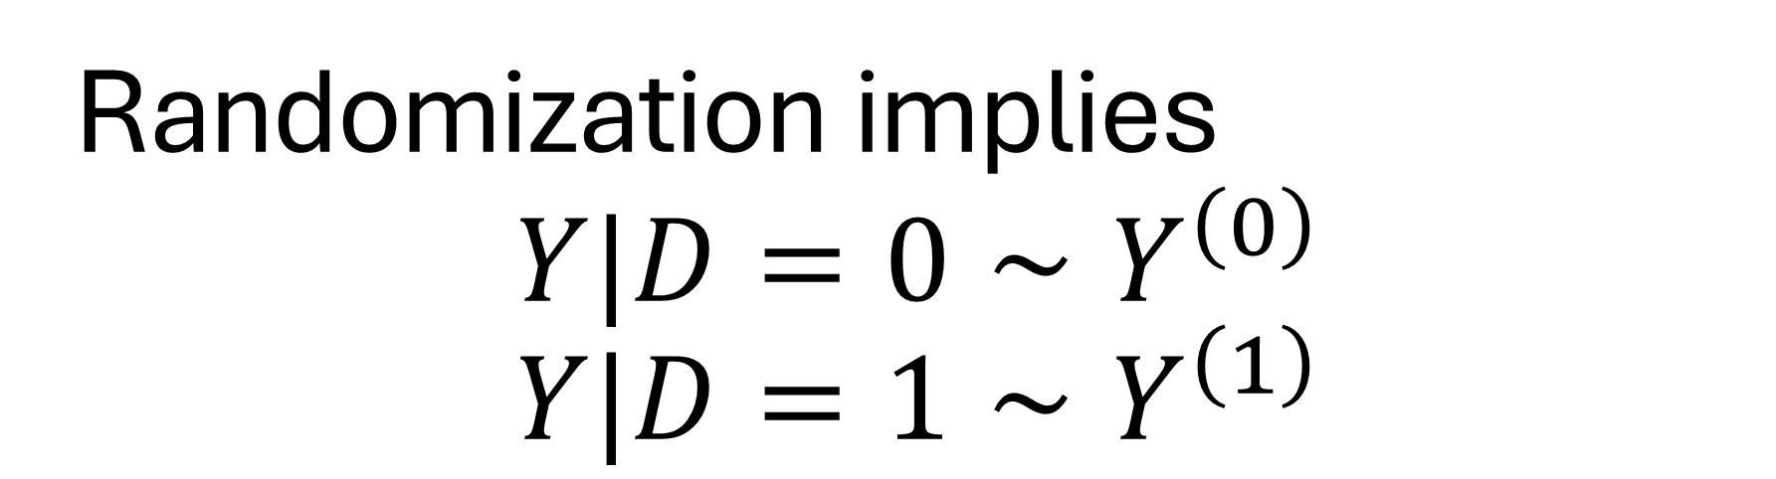
Randomization implies $$Y|D=0∼Y^{\left(0\right)} \\ Y|D=1∼Y^{\left(1\right)}$$

Slide 30
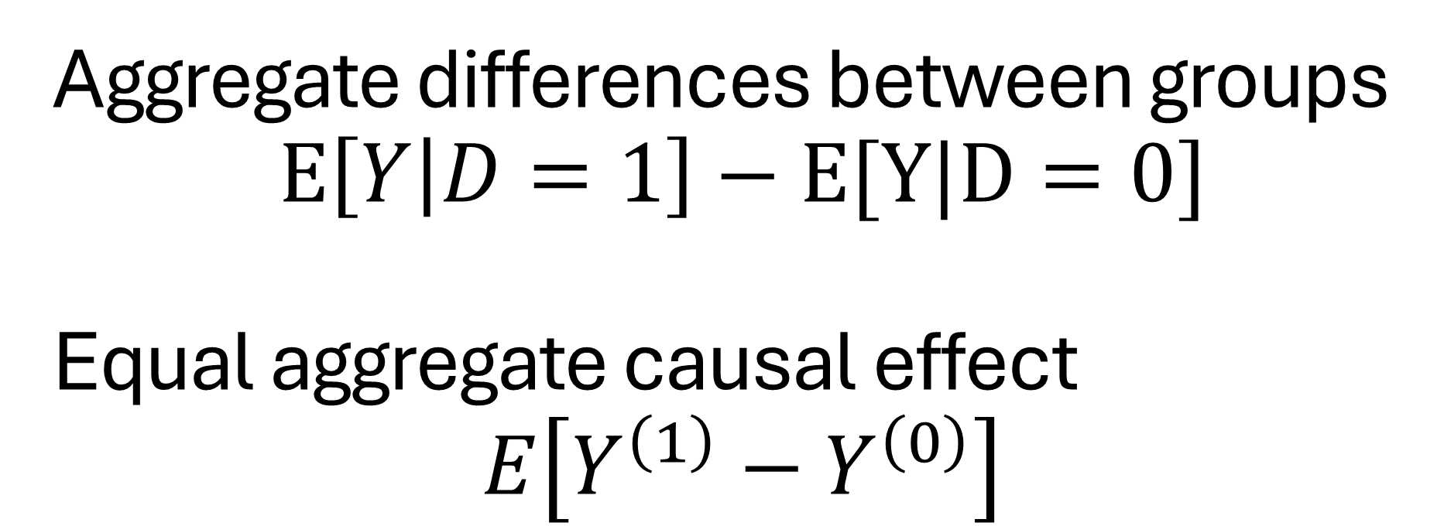
Aggregate differences between groups $$E\left[Y | D=1\right]−E[Y|D=0]$$ Equal aggregate causal effect $$E\left[Y^{\left(1\right)}−Y^{\left(0\right)}\right]$$

Slide 31
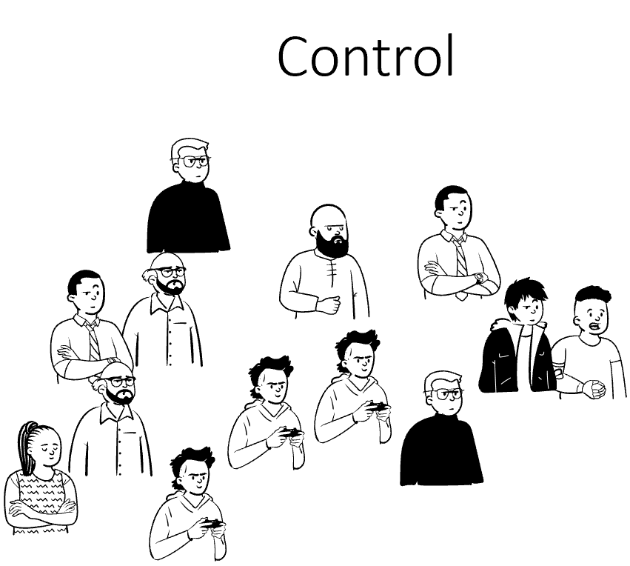

Historical Data
% of people
Group A
A
$$Y∣A$$
$μ_{A}=10\$$ (average spend)
% of people
Group B
B
$$Y∣B$$
$μ_{B}=20\$$ (average spend)
Image Source: https://www.leadpages.com/blog/ab-testing-split-testing/

Slide 32
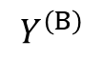
Historical Data
% of people
Group A
A
$$Y∣A$$
$μ_{A}=10\$$ (average spend)
% of people
% of people
Group B
Counterfactual Outcome
$$Y^{\left(B\right)}$$
B
$$Y∣B$$
$μ_{B}=20\$$ (average spend)
Image Source: https://www.leadpages.com/blog/ab-testing-split-testing/

Slide 33




Historical Data
Image source: https://www.linkedin.com/pulse/why-90-fortune-500-companies-now-using-microsoft-cloud-natasha-spurr/
% of companies
Group A
No cloud specialist
A
$$Y∣A$$
$μ_{A}=10\$$ (average spend)
% of companies
Assign Cloud Specialist
Group B
B
$$Y∣B$$
Fortune500
$μ_{B}=20\$$ (average spend)

Slide 34
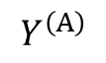
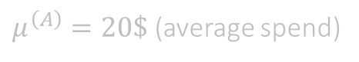
Historical Data
Image source: https://www.linkedin.com/pulse/why-90-fortune-500-companies-now-using-microsoft-cloud-natasha-spurr/
% of companies
% of companies
Counterfactual outcome
Group A
No cloud specialist
$$Y^{\left(A\right)}$$
A
$$Y∣A$$
$μ_{A}=10\$$ (average spend)
$μ^{\left(A\right)}=20\$$ (average spend)
% of companies
Assign Cloud Specialist
Group B
B
$$Y∣B$$
Fortune500
$μ_{B}=20\$$ (average spend)

Slide 35
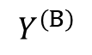
Historical Data
Image source: https://www.linkedin.com/pulse/why-90-fortune-500-companies-now-using-microsoft-cloud-natasha-spurr/
% of companies
% of companies
Counterfactual outcome
Group A
No cloud specialist
$$Y^{\left(A\right)}$$
A
$$Y∣A$$
$μ_{A}=10\$$ (average spend)
$μ^{\left(A\right)}=20\$$ (average spend)
% of companies
% of companies
Assign Cloud Specialist
Group B
Counterfactual Outcome
B
$$Y∣B$$
$$Y^{\left(B\right)}$$
Fortune500
$μ_{B}=20\$$ (average spend)
$μ^{\left(B\right)}=20\$$ (average spend)

Slide 36
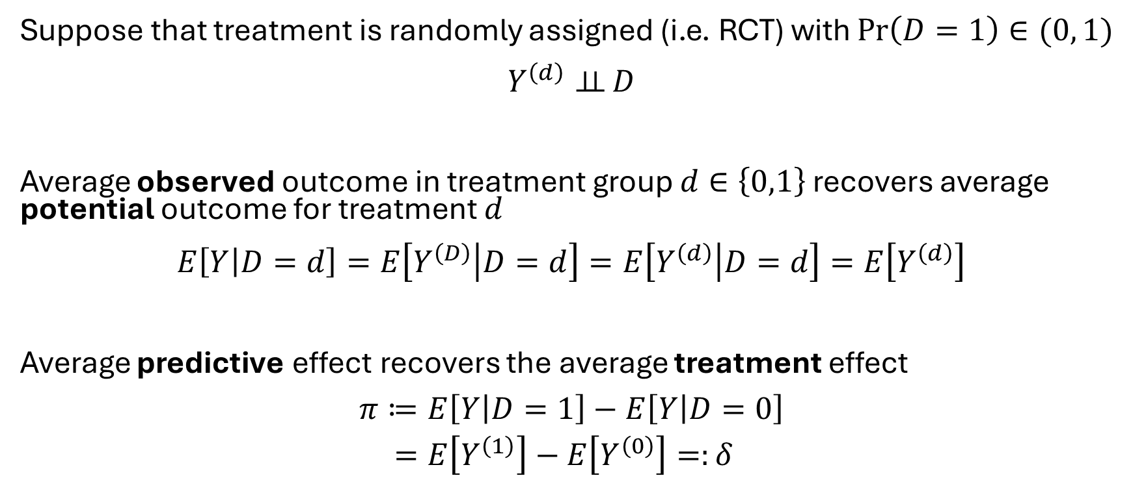
Identification of ATE in RCTs
Suppose that treatment is randomly assigned (i.e. RCT) with $\operatorname{Pr}\left(D=1\right)∈(0, 1)$
$$Y^{\left(d\right)}⊥⊥ D$$
Average observed outcome in treatment group $d∈\left\{0,1\right\}$ recovers average potential outcome for treatment $d$
$$E\left[Y | D=d\right]=E\left[Y^{\left(D\right)} | D=d\right]=E\left[Y^{\left(d\right)} | D=d\right]=E\left[Y^{\left(d\right)}\right]$$
Average predictive effect recovers the average treatment effect
$$\begin{aligned}π≔&E\left[Y | D=1\right]−E\left[Y | D=0\right] \\ =&E\left[Y^{\left(1\right)}\right]−E\left[Y^{\left(0\right)}\right]=:δ\end{aligned}$$

Slide 37
Limitations of RCTs

Slide 38
Externalities, Stability and Equilibrium Effects
Stable Unit Treatment Value Assumption (SUTVA)
Implicit in our notation the potential outcome of a unit depends only on its own treatment
This can be violated due to what is known as spillover effects, externalities or general equilibrium effects
In vaccine trials: if large fraction of population is treated, then the effect of vaccinating an additional unity changes, due to herd immunity
In labor: if we make an intervention that incentivizes a large fraction of population to attend college, the college-wage premium will likely decrease

Slide 39
Ethical, Practical and Generalizability Concerns
Ethical Concerns: Many potential trials would correctly be judged unethical by a human subject trial review board; Key principles [78 Belmont report]: (i) respect for persons, (ii) beneficence, (iii) justice
Practical Concerns: Practically infeasible due to high cost (e.g. expensive treatment, expensive data collection, low signal regime, long-term outcomes) or inability to directly randomize the treatment
Generalizability: Local population used for RCT might not generalize to broader population

Slide 40

Statistics

Slide 41
Statistics
% of people
Sampled A
A
$$Y∣A$$
$μ_{A}=10\$$ (average spend)
% of people
Sampled B
B
$$Y∣B$$
$μ_{B}=20\$$ (average spend)
Image Source: https://www.leadpages.com/blog/ab-testing-split-testing/

Slide 42
Statistics
% of people
all user base
Sampled A
A
$$Y∣A$$
$μ_{A}=10\$$ (average spend)
% of people
all user base
Sampled B
B
$$Y∣B$$
$μ_{B}=20\$$ (average spend)
Image Source: https://www.leadpages.com/blog/ab-testing-split-testing/

Slide 43

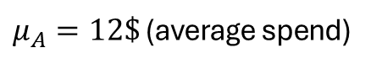
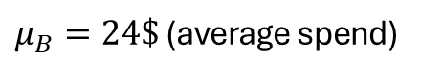
Statistics
% of people
all user base
% of people
Sampled A
A
$$Y∣A$$
$μ_{A}=10\$$ (average spend)
$μ_{A}=12\$$ (average spend)
% of people
all user base
% of people
Sampled B
B
$$Y∣B$$
$μ_{B}=20\$$ (average spend)
$μ_{B}=24\$$ (average spend)
Image Source: https://www.leadpages.com/blog/ab-testing-split-testing/

Slide 44
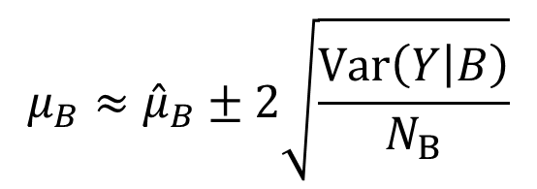
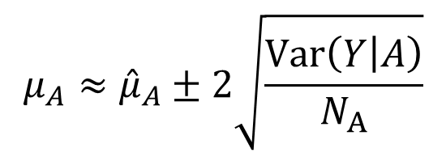
Statistics
with probability 95%
% of people
Sampled A
population mean
A
$$Y∣A$$
$$μ_{A}≈{\hat{μ}}_{A}±2\sqrt{\frac{Var\left(Y | A\right)}{N_{A}}}$$
sample mean
sampling error
$μ_{A}=10\$$ (average spend)
% of people
population mean
Sampled B
B
$$Y∣B$$
$$μ_{B}≈{\hat{μ}}_{B}±2\sqrt{\frac{Var\left(Y | B\right)}{N_{B}}}$$
sample mean
sampling error
$μ_{B}=20\$$ (average spend)
Image Source: https://www.leadpages.com/blog/ab-testing-split-testing/

Slide 45
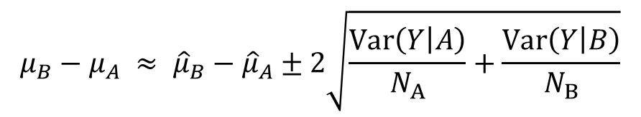
Statistics
with probability 95%
% of people
Sampled A
A
$$Y∣A$$
$μ_{A}=10\$$ (average spend)
$$μ_{B}−μ_{A} ≈ {\hat{μ}}_{B}−{\hat{μ}}_{A}±2\sqrt{\frac{Var\left(Y | A\right)}{N_{A}}+\frac{Var\left(Y | B\right)}{N_{B}}}$$
% of people
Sampled B
B
$$Y∣B$$
population effect
sample effect
sampling error
$μ_{B}=20\$$ (average spend)
Image Source: https://www.leadpages.com/blog/ab-testing-split-testing/

Slide 46
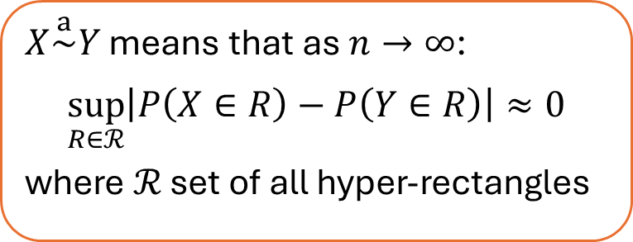
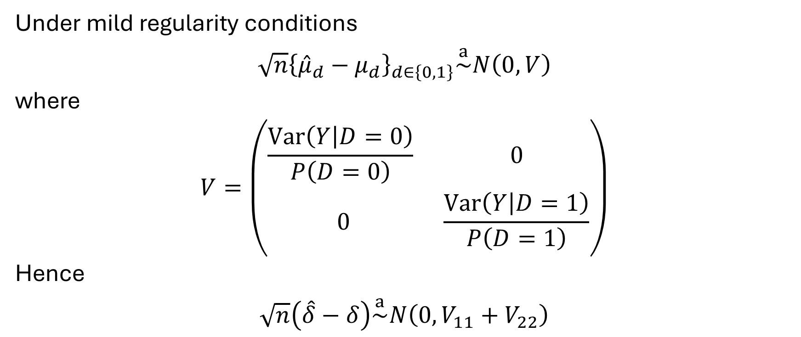
More formally
$X\overset{a}{\sim }Y$ means that as $n→∞$:
$$\sup_{R∈ℛ}\left|P\left(X∈R\right)−P\left(Y∈R\right)\right|≈0$$
where $ℛ$ set of all hyper-rectangles
Under mild regularity conditions
$$\sqrt{n}{\left\{{\hat{μ}}_{d}−μ_{d}\right\}}_{d∈\left\{0,1\right\}}\overset{a}{\sim }N\left(0, V\right)$$
where
$$V=\left(\begin{matrix}\frac{Var\left(Y | D=0\right)}{P\left(D=0\right)} & 0 \\ 0 & \frac{Var\left(Y | D=1\right)}{P\left(D=1\right)}\end{matrix}\right)$$
Hence
$$\sqrt{n}\left(\hat{δ}−δ\right)\overset{a}{\sim }N\left(0, V_{11}+V_{22}\right)$$

Slide 47
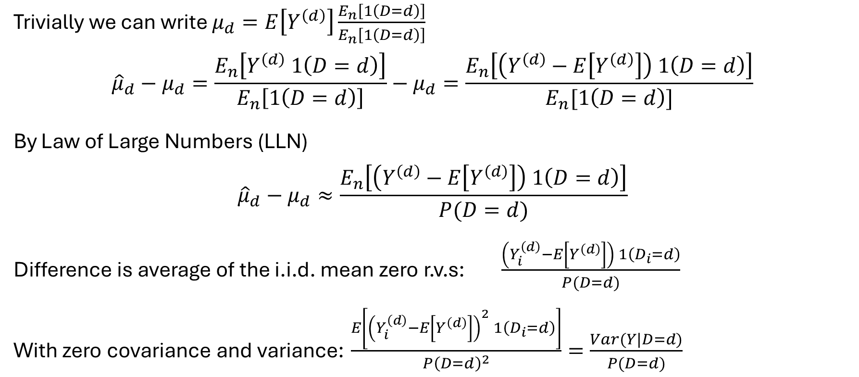
Proof Sketch
Trivially we can write $μ_{d}=E\left[Y^{\left(d\right)}\right]\frac{E_{n}\left[1\left(D=d\right)\right]}{E_{n}\left[1\left(D=d\right)\right]}$
$${\hat{μ}}_{d}−μ_{d}=\frac{E_{n}\left[Y^{\left(d\right)} 1\left(D=d\right)\right]}{E_{n}\left[1\left(D=d\right)\right]}−μ_{d}=\frac{E_{n}\left[\left(Y^{\left(d\right)}−E\left[Y^{\left(d\right)}\right]\right) 1\left(D=d\right)\right]}{E_{n}[1\left(D=d\right)]}$$
By Law of Large Numbers (LLN)
$${\hat{μ}}_{d}−μ_{d}≈\frac{E_{n}\left[\left(Y^{\left(d\right)}−E\left[Y^{\left(d\right)}\right]\right) 1\left(D=d\right)\right]}{P(D=d)}$$
Difference is average of the i.i.d. mean zero r.v.s: $\frac{\left(Y_{i}^{\left(d\right)}−E\left[Y^{\left(d\right)}\right]\right) 1\left(D_{i}=d\right)}{P(D=d)}$
With zero covariance and variance: $\frac{E\left[{\left(Y_{i}^{\left(d\right)}−E\left[Y^{\left(d\right)}\right]\right)}^{2} 1\left(D_{i}=d\right)\right]}{P{\left(D=d\right)}^{2}}=\frac{Var(Y|D=d)}{P(D=d)}$
Statement follows by Central Limit Theorem (CLT)

Slide 48
Variance estimate
Same statement also holds with consistent estimate of variance
$$\hat{V}=\left(\begin{matrix}\frac{{Var}_{n}\left(Y | D=0\right)}{E_{n}\left[1−D\right]} & 0 \\ 0 & \frac{{Var}_{n}\left(Y | D=1\right)}{E_{n}\left[D\right]}\end{matrix}\right)$$

Slide 49
Confidence Interval
$X\overset{a}{\sim }Y≡$ $\sup_{\left[ℓ,u\right]}\left|P\left(X∈\left[ℓ,u\right]\right)−P\left(Y∈\left[ℓ,u\right]\right)\right|≈0$
If we consider $\left[ℓ, u\right]$ the $\left(\frac{α}{2},1−\frac{α}{2}\right)$ quantile of $N\left(0, \hat{V}\right)$ then
$$P\left(\sqrt{n}\left(\hat{δ}−δ\right)∈\left[ℓ,u\right]\right)≈1−α$$
Equivalently, let $z_{α}$ the $α$ quantile of $N\left(0,1\right)$ and ${\hat{σ}}_{n}=\sqrt{\hat{V}/n}$ then:
$$P\left(δ∈\left[\hat{δ}−z_{1−\frac{α}{2}}{\hat{σ}}_{n},\hat{δ}+z_{1−\frac{α}{2}}{\hat{σ}}_{n}\right]\right)≈1−α$$
Standard error

Slide 50
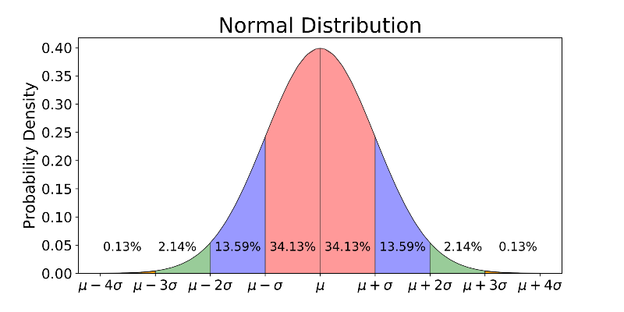
Confidence Interval
$$\hat{δ}−4{\hat{σ}}_{n}$$
$$\hat{δ}−3{\hat{σ}}_{n}$$
$$\hat{δ}−2{\hat{σ}}_{n}$$
$$\hat{δ}−{\hat{σ}}_{n}$$
$$\hat{δ}$$
$$\hat{δ}+{\hat{σ}}_{n}$$
$$\hat{δ}+2{\hat{σ}}_{n}$$
$$\hat{δ}+3{\hat{σ}}_{n}$$
$$\hat{δ}+4{\hat{σ}}_{n}$$
95% CI $≈\left[\hat{δ}−1.96 {\hat{σ}}_{n}, \hat{δ}+1.96 {\hat{σ}}_{n}\right]$
Let’s try it out!

Slide 51
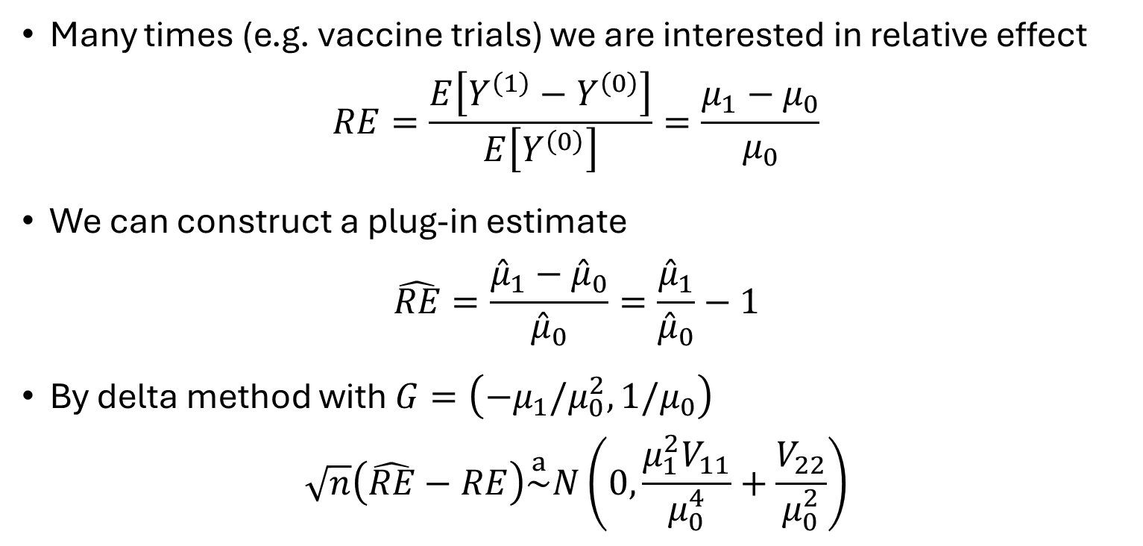
Relative effect
Many times (e.g. vaccine trials) we are interested in relative effect
$$RE=\frac{E\left[Y^{\left(1\right)}−Y^{\left(0\right)}\right]}{E\left[Y^{\left(0\right)}\right]}=\frac{μ_{1}−μ_{0}}{μ_{0}}$$
We can construct a plug-in estimate
$$\hat{RE}=\frac{{\hat{μ}}_{1}−{\hat{μ}}_{0}}{{\hat{μ}}_{0}}=\frac{{\hat{μ}}_{1}}{{\hat{μ}}_{0}}−1$$
By delta method with $G=\left(−μ_{1}/μ_{0}^{2},1/μ_{0}\right)$
$$\sqrt{n}\left(\hat{RE}−RE\right)\overset{a}{\sim }N\left(0,\frac{μ_{1}^{2}V_{11}}{μ_{0}^{4}}+\frac{V_{22}}{μ_{0}^{2}}\right)$$
Delta method: for any function $f$, with $G=∇f\left(θ\right)$
$$\sqrt{n}\left(f\left(\hat{θ}\right)−f\left(θ\right)\right)≈G \sqrt{n}\left(\hat{θ}−θ\right)\overset{a}{\sim }N\left(0, G^{′}VG\right)$$

Slide 52
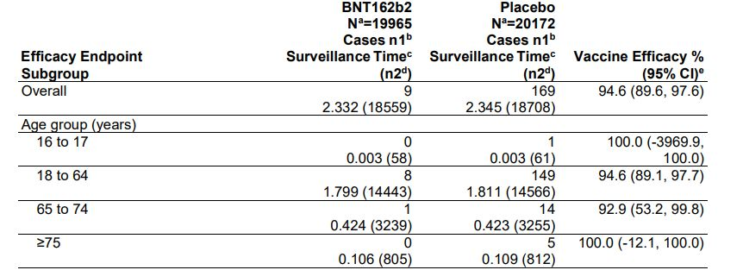
Example: Pfizer Vaccine

Slide 53
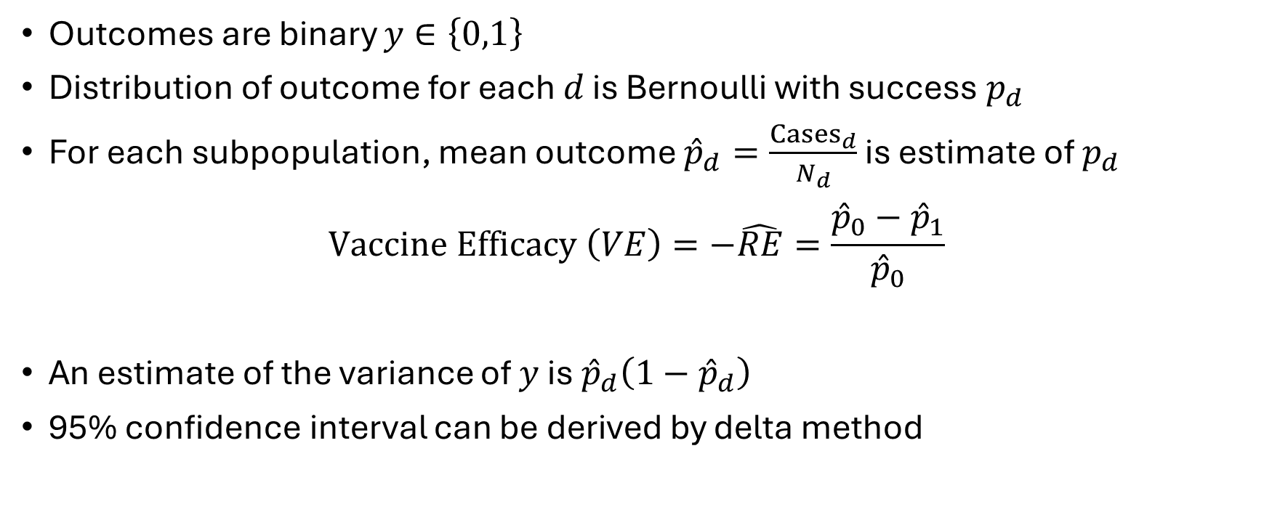
Approximate Confidence Interval
Outcomes are binary $y∈\left\{0,1\right\}$
Distribution of outcome for each $d$ is Bernoulli with success $p_{d}$
For each subpopulation, mean outcome ${\hat{p}}_{d}=\frac{{Cases}_{d}}{N_{d}}$ is estimate of $p_{d}$
$$Vaccine Efficacy \left(VE\right)=−\hat{RE}=\frac{{\hat{p}}_{0}−{\hat{p}}_{1}}{{\hat{p}}_{0}}$$
An estimate of the variance of $y$ is ${\hat{p}}_{d}\left(1−{\hat{p}}_{d}\right)$
95% confidence interval can be derived by delta method
Let’s try it out!

Slide 54
Pre-Treatment Covariates
Heterogeneity, Checks, and Precision

Slide 55
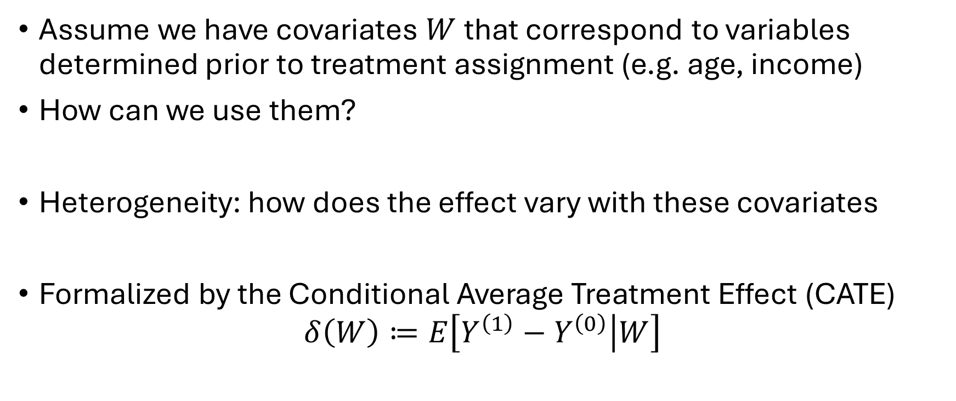
Pre-Treatment Covariates
Assume we have covariates $W$ that correspond to variables determined prior to treatment assignment (e.g. age, income)
How can we use them?
Heterogeneity: how does the effect vary with these covariates
Formalized by the Conditional Average Treatment Effect (CATE)
$$δ\left(W\right)≔E\left[Y^{\left(1\right)}−Y^{\left(0\right)} | W\right]$$

Slide 56
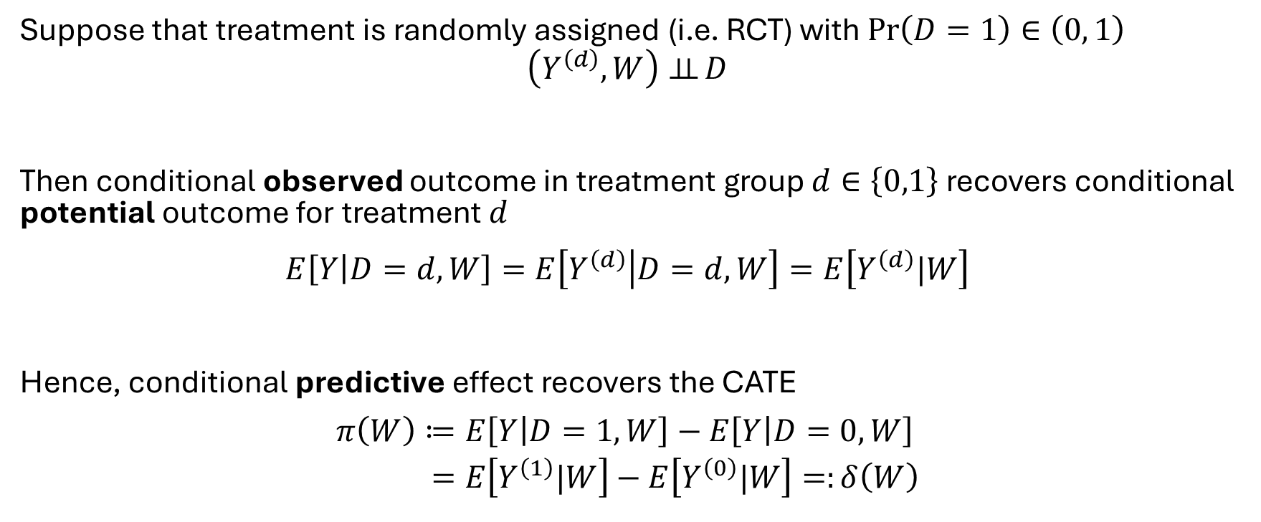
Identification of CATE under Random Assignment
Suppose that treatment is randomly assigned (i.e. RCT) with $\operatorname{Pr}\left(D=1\right)∈\left(0, 1\right)$
$$\left(Y^{\left(d\right)},W\right)⊥⊥ D$$
Then conditional observed outcome in treatment group $d∈\left\{0,1\right\}$ recovers conditional potential outcome for treatment $d$
$$E\left[Y | D=d,W\right]=E\left[Y^{\left(d\right)} | D=d,W\right]=E\left[Y^{\left(d\right)}|W\right]$$
Hence, conditional predictive effect recovers the CATE
$$\begin{aligned}π\left(W\right)≔&E\left[Y | D=1,W\right]−E\left[Y | D=0,W\right] \\ =&E\left[Y^{\left(1\right)}|W\right]−E\left[Y^{\left(0\right)}|W\right]=:δ\left(W\right)\end{aligned}$$

Slide 57
If we only care about ATE are co-variates useful?

Slide 58
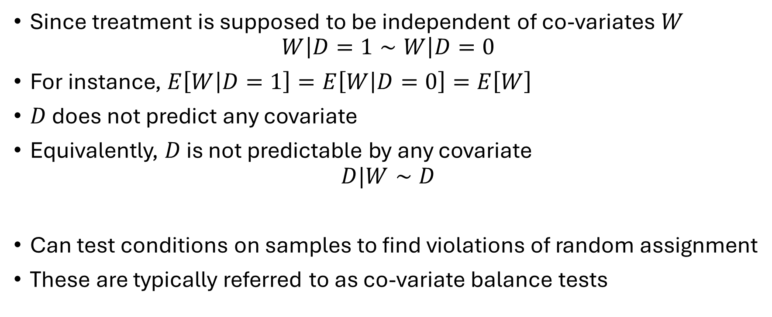
Co-variates for Sanity Check
Since treatment is supposed to be independent of co-variates $W$
$$W\left|D=1∼W\right|D=0$$
For instance, $E\left[W | D=1\right]=E\left[W | D=0\right]=E\left[W\right]$
$D$ does not predict any covariate
Equivalently, $D$ is not predictable by any covariate
$$D|W∼D$$
Can test conditions on samples to find violations of random assignment
These are typically referred to as co-variate balance tests

Slide 59
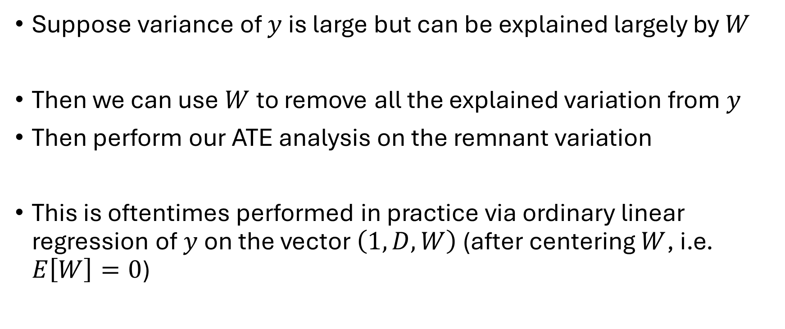
Co-variates for Precision
Suppose variance of $y$ is large but can be explained largely by $W$
Then we can use $W$ to remove all the explained variation from $y$
Then perform our ATE analysis on the remnant variation
This is oftentimes performed in practice via ordinary linear regression of $y$ on the vector $\left(1, D, W\right)$ (after centering $W$, i.e. $E\left[W\right]=0$)

Slide 60
Is this consistent?
Suppose that the conditional expectation function (CEF) of the outcome is indeed linear, with $(D,1,W)$
$$E\left[Y ∣ D, W\right]=Dα+α_{0}+W^{′}β$$
Then note that
$$E\left[Y\left(0\right)\right]=E\left[E\left[Y | D=0,W\right]\right]=α_{0}$$
$$E\left[Y\left(1\right)\right]=E\left[E\left[Y | D=1, W\right]\right]=α+α_{0}$$
Baseline outcome is coefficient associated with the intercept $1$
Average effect is coefficient associated with treatment $D$
Next lecture: this does not require the linear CEF assumption

Slide 61
Appendix

Slide 62
Analysis of Variance (ANOVA)
Sneak peek into some material from next lecture

Slide 63
Variance of Estimate
The OLS theory that we will cover in the next section yields
$$\sqrt{n}\left(\hat{α}−α\right)\overset{a}{\sim }N\left(0, V_{α}\right) V_{α}=\frac{E\left[ε^{2}{\tilde{D}}^{2}\right]}{E{\left[{\tilde{D}}^{2}\right]}^{2}}$$
$ε$ is residual outcome:
$$ε=y −Dα−α_{0}−W^{′}β E\left[ε | D,W\right]=0 (by Linear CEF)$$
$\tilde{D}$ is residual treatment (removing whatever is linearly predictable from $(1, W)$)
$$\tilde{D}=D−E\left[D\right]$$

Slide 64
Variance without adjustment
OLS theory that we will cover in the next section yields
$$V_{α}=\frac{E\left[ε^{2}{\tilde{D}}^{2}\right]}{E{\left[{\tilde{D}}^{2}\right]}^{2}}$$
$ε$ is residual outcome: $ε=y −Dα−α_{0}−W^{′}β$ with $E\left[ε | D,W\right]=0$
Two means estimate is equivalent to OLS without $W$. OLS theory gives variance ${\overline{V}}_{α}$ of same form but with residual:
$$\overline{ε}=y−Dα−α_{0}=W^{′}β+ε$$
$$\begin{aligned}E\left[{\overline{ε}}^{2}{\tilde{D}}^{2}\right]=&E\left[{\left(W^{′}β+ε\right)}^{2}{\tilde{D}}^{2}\right] \\ =&E\left[{\left(W^{′}β\right)}^{2}{\tilde{D}}^{2}\right]+E\left[ε^{2}{\tilde{D}}^{2}\right]+2E\left[β′Wε{\tilde{D}}^{2}\right] \\ =&E\left[{\left(W^{′}β\right)}^{2}{\tilde{D}}^{2}\right]+E\left[ε^{2}{\tilde{D}}^{2}\right]+2E\left[β^{′}WE\left[ε ∣ D,X\right]{\tilde{D}}^{2}\right] \\ =&E\left[{\left(W^{′}β\right)}^{2}{\tilde{D}}^{2}\right]+E\left[ε^{2}{\tilde{D}}^{2}\right]\end{aligned}$$
$${\overline{V}}_{α}≥V_{α}$$
Variance of OLS estimate with extra co-variates (adjusted) is weakly smaller than two-means estimate (un-adjusted)

Slide 65
Heteroskedasticity Robust Variance
Variance formula
$$V_{α}=\frac{E\left[ε^{2}{\tilde{D}}^{2}\right]}{E{\left[{\tilde{D}}^{2}\right]}^{2}}$$
is valid even when the linear CEF assumption is violated
Inference is asymptotically valid!
Important to note that this formula is known as the “heteroskedasticity robust variance formula” (HC0)
Many software packages make the simplification that the residual $ε$ is independent of $D,W$, leading to $V_{α}=E\left[ε^{2}\right]/E\left[{\tilde{D}}^{2}\right]$. This is incorrect in most cases!

Slide 66
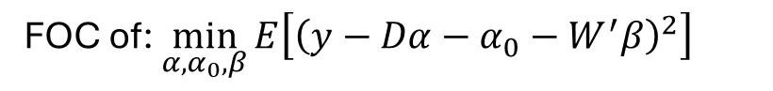
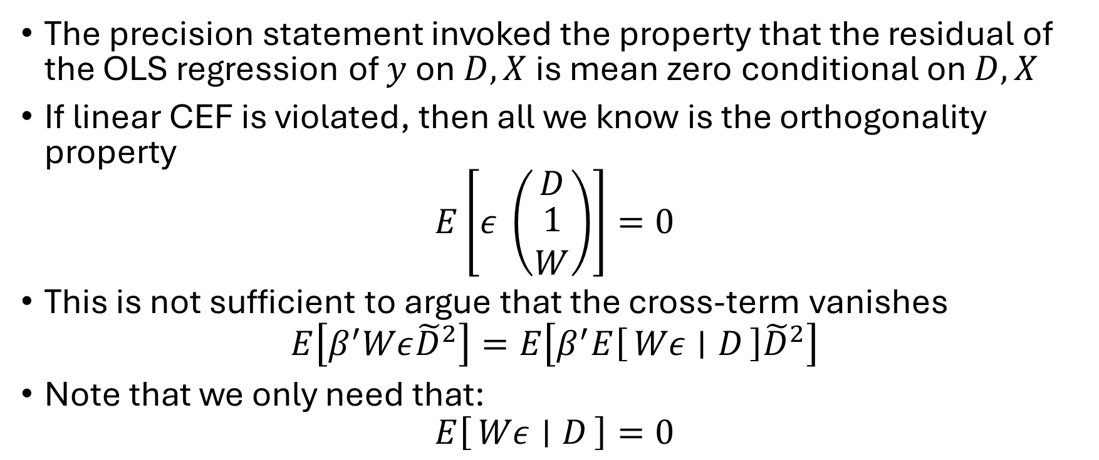
Precision Beyond Linear CEF
The precision statement invoked the property that the residual of the OLS regression of $y$ on $D,X$ is mean zero conditional on $D, X$
If linear CEF is violated, then all we know is the orthogonality property
$$E\left[ε \left(\begin{matrix}D \\ \begin{aligned}1 \\ W\end{aligned}\end{matrix}\right)\right]=0$$
This is not sufficient to argue that the cross-term vanishes
$$E\left[β^{′}Wε{\tilde{D}}^{2}\right]=E\left[β^{′}E\left[Wε ∣ D\right]{\tilde{D}}^{2}\right]$$
Note that we only need that:
$$E\left[Wε ∣ D\right]=0$$
FOC of: $\min_{α,α_{0},β}{E\left[{\left(y−Dα−α_{0}−W^{′}β\right)}^{2}\right]}$
Let’s try it out!

Slide 67
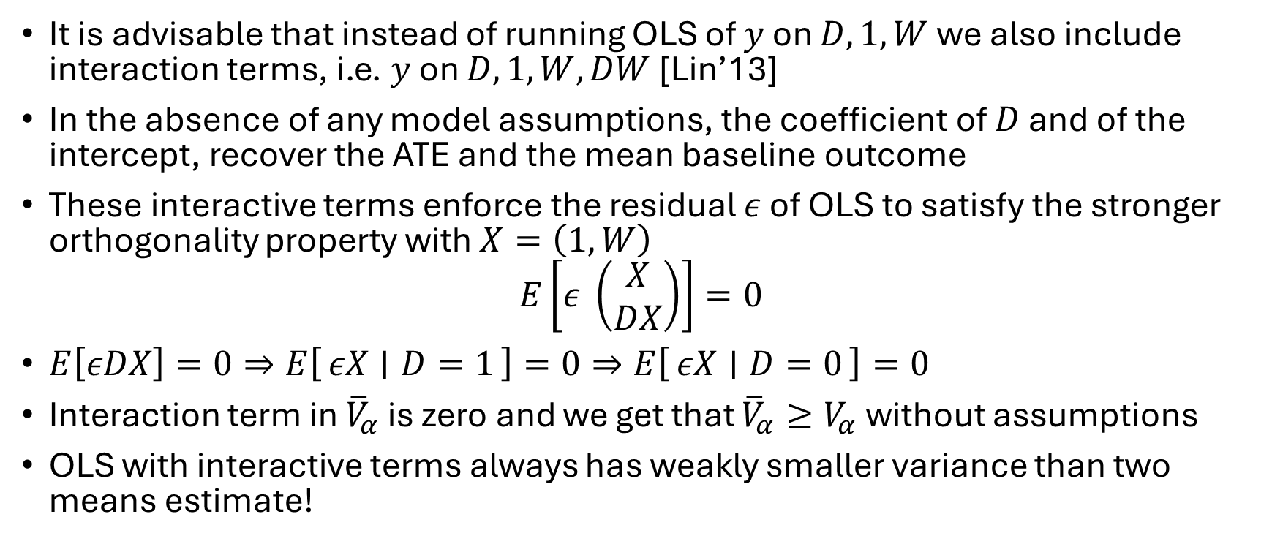
OLS with Interactive Terms
It is advisable that instead of running OLS of $y$ on $D, 1,W$ we also include interaction terms, i.e. $y$ on $D, 1, W,DW$ [Lin’13]
In the absence of any model assumptions, the coefficient of $D$ and of the intercept, recover the ATE and the mean baseline outcome
These interactive terms enforce the residual $ε$ of OLS to satisfy the stronger orthogonality property with $X=\left(1,W\right)$
$$E\left[ε \left(\begin{matrix}X \\ DX\end{matrix}\right)\right]=0$$
$E\left[εDX\right]=0⇒E\left[εX ∣ D=1\right]=0⇒E\left[εX ∣ D=0\right]=0$
Interaction term in ${\overline{V}}_{α}$ is zero and we get that ${\overline{V}}_{α}≥V_{α}$ without assumptions
OLS with interactive terms always has weakly smaller variance than two means estimate!
Let’s try it out!

Slide 68
Even if you only care about ATE, if you have $p$ covariates and $p≪n$ run OLS with interactive terms!
Guaranteed improved precision, plus can uncover potential dimensions of heterogeneity

Slide 69
Example: Heterogeneous Effects
effect modifier
ATE
Suppose that:
$$E\left[y ∣ D,X\right]=Dα+α_{0}+DW^{′}γ+W^{′}β$$
What OLS is estimating is the solution to:
$$E\left[\left(y−D\tilde{α}−{\tilde{α}}_{0}−W^{′}\tilde{β}\right)\left(\begin{matrix}D \\ X\end{matrix}\right)\right]=0$$
$$E\left[\left(Dα+α_{0}+DW^{′}γ+W^{′}β−D\tilde{α}−{\tilde{α}}_{0}−W^{′}\tilde{β}\right)\left(\begin{matrix}D \\ X\end{matrix}\right)\right]=0$$
Since $E\left[W\right]=0$ and $W⊥D$: $α=\tilde{α},α_{0}={\tilde{α}}_{0}$
But $\tilde{β}=β+E\left[D\right]γ$
Residual of OLS is $ε=\tilde{D}W^{′}γ+ν$ with $E\left[ν | D,W\right]=0$
Then interaction term is:
$$E\left[β^{′}Wε{\tilde{D}}^{2}\right]=E\left[{\tilde{D}}^{3}\right] β^{′}E\left[WW^{′}\right]γ≠0$$

